Slide 1
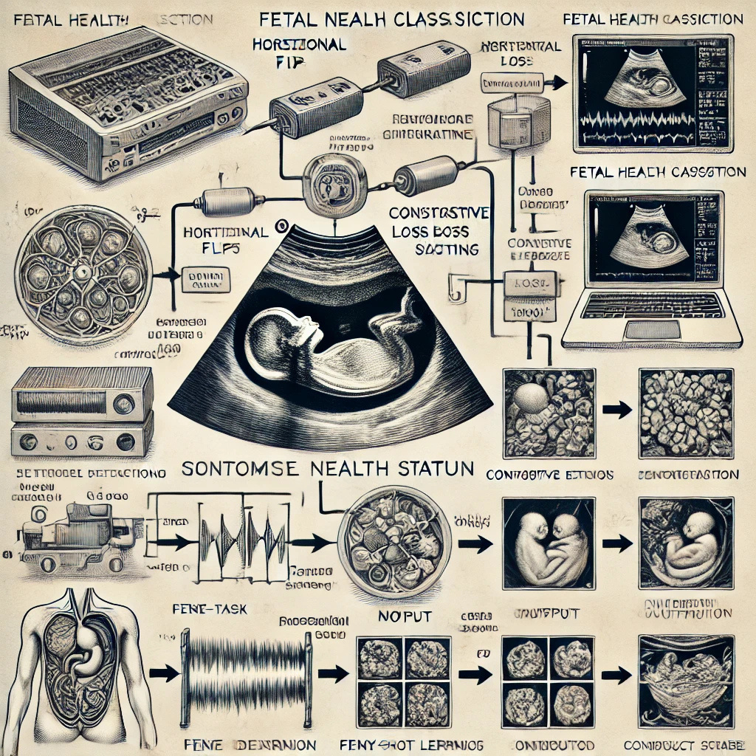


PREDICTIVE ANALYTICS FOR FETAL HEALTH: A MACHINE LEARNING FRAMEWORK FOR EARLY RISK ASSESSMENT
Group - 2
Pushkar Charkha - 02
Suyog Bodke - 06
Gitesh Tamboli - 07
Vaibhav Kumar Singh - 10

Slide 2


CONTENTS OF THE PRESENTATION
Problem Statement
Architecture & Flow Diagram
Comparison with other Models
Introduction
Implementation Details
Unique Conribution in Project
Literature Survey
Result - EDA
Conclusion and Future Scope
Methodology
Results of Model
References

Slide 3
PROBLEM STATEMENT
Fetal health assessment is a critical component of prenatal care, requiring accurate and timely diagnosis of abnormalities to mitigate risks.
Traditional methods rely heavily on manual interpretation of ultrasound images and numerical health metrics, which can be subjective and time-consuming.
Fragmented diagnostic approaches analyze ultrasound images, fetal metrics, and maternal health data separately, missing critical correlations.
High inter-observer variability in manual ultrasound interpretation leads to inconsistent diagnoses, especially in resource-limited settings.
Late detection of fetal abnormalities occurs due to lack of standardized, automated tools, delaying life-saving interventions.

Slide 4


INTRODUCTION
Existing Work
Traditional diagnosis methods rely heavily on manual examination of ultrasound images.
Lack of automated systems leads to delayed results.
Most existing models require large datasets and struggle with real-time inference.
Proposed Method
Developed a Siamese Neural Network (SNN) to classify fetal health using both ultrasound images and clinical data.
Employed a few-shot learning approach for accurate classification using limited labeled data.
Integrated a multi-modal data fusion technique for comprehensive analysis.
Implemented real-time inference capabilities for clinical use.

Slide 5
LITERATURE SURVEY
Paper Title | Authors | Algorithm Used | Accuracy (%) | Key Findings | Link
Unsupervised Detection of Fetal Brain Anomalies using Denoising Diffusion Models | Markus Ditlev Sjogren Olsen, Jakob Ambsdorf, Manxi Lin, etc. | Denoising Diffusion Probabilistic Models | AUROC scores ranging from 0.57 to 0.76 | The unsupervised iNAAD framework achieves comparable or superior performance to supervised methods for localized anomalies. Gaussian noise in DDPMs performs best for fetal ultrasound anomaly detection, unlike MRI settings where Simplex/Pyramid noise excels. | link
Automatic Estimation of Fetal Abdominal Circumference from Ultrasound Images | Jaeseong Jang, Yejin Park, Bukweon Kim, etc. | Custom CNN | 80.9 | The CNN integrates ultrasound propagation direction and multi-scale patches to improve classification with limited training data. The method handles shadowing artifacts but struggles with oversized fetuses or distorted abdominal regions. | link
A Review on Deep-Learning Algorithms for Fetal Ultrasound-Image Analysis | Maria Chiara Fiorentino, Francesca Pia Villani, etc. | Standard-Plane Detection: DenseNet-169 Biometry Estimation: U-Net | 94 | The paper reviews 145 research papers published after 2017, categorizing them into fetal standard-plane detection, anatomical-structure analysis, and biometry parameter estimation. | link

Slide 6
Paper Title | Authors | Algorithm Used | Accuracy (%) | Key Findings | Link
FPUS23: An Ultrasound Fetus Phantom Dataset with Deep Neural Network Evaluations for Fetus Orientations, Fetal Planes, and Anatomical Features | Bharath Srinivas Prabakaran, Paul Hamelmann, Erik Ostrowski, Muhammad Shafique | Fine-tuned ResNet34 | - | The FPUS23 dataset improves the accuracy of deep learning models for fetal ultrasound analysis. The trained models can be used to aid healthcare professionals and support at-home ultrasound-based fetal monitoring. | link
Semi-supervised Learning of Fetal Anatomy from Ultrasound | Jeremy Tan, Anselm Au, Qingjie Meng, Bernhard Kainz | semi-supervised learning (SSL) framework | ~70 | Impact of Background Class: Inclusion of a challenging background class in unlabelled data often degraded SSL performance, highlighting the sensitivity of SSL to confounding data. Class Similarity Matters: SSL improved performance for distinct anatomical classes but increased confusion for similar classes (e.g., cardiac views), suggesting domain-specific adjustments (e.g., lower confidence thresholds) are needed. | link
Weakly Supervised Localisation for Fetal Ultrasound Images | Nicolas Toussaint, Bishesh Khanal, Matthew Sinclair, Alberto Gomez, etc. | CNNs coupled with VGG13-SP, VGG16-SP, ResNet18-SP, and ResNet34-SP | 90 | The proposed method achieves high classification accuracy (~90%) for fetal anatomical regions using only image-level labels, demonstrating the effectiveness of weakly supervised learning in medical imaging. The soft proposal maps correlate well with relevant anatomical structures, enabling localisation without explicit bounding box annotations during training. | link

Slide 7
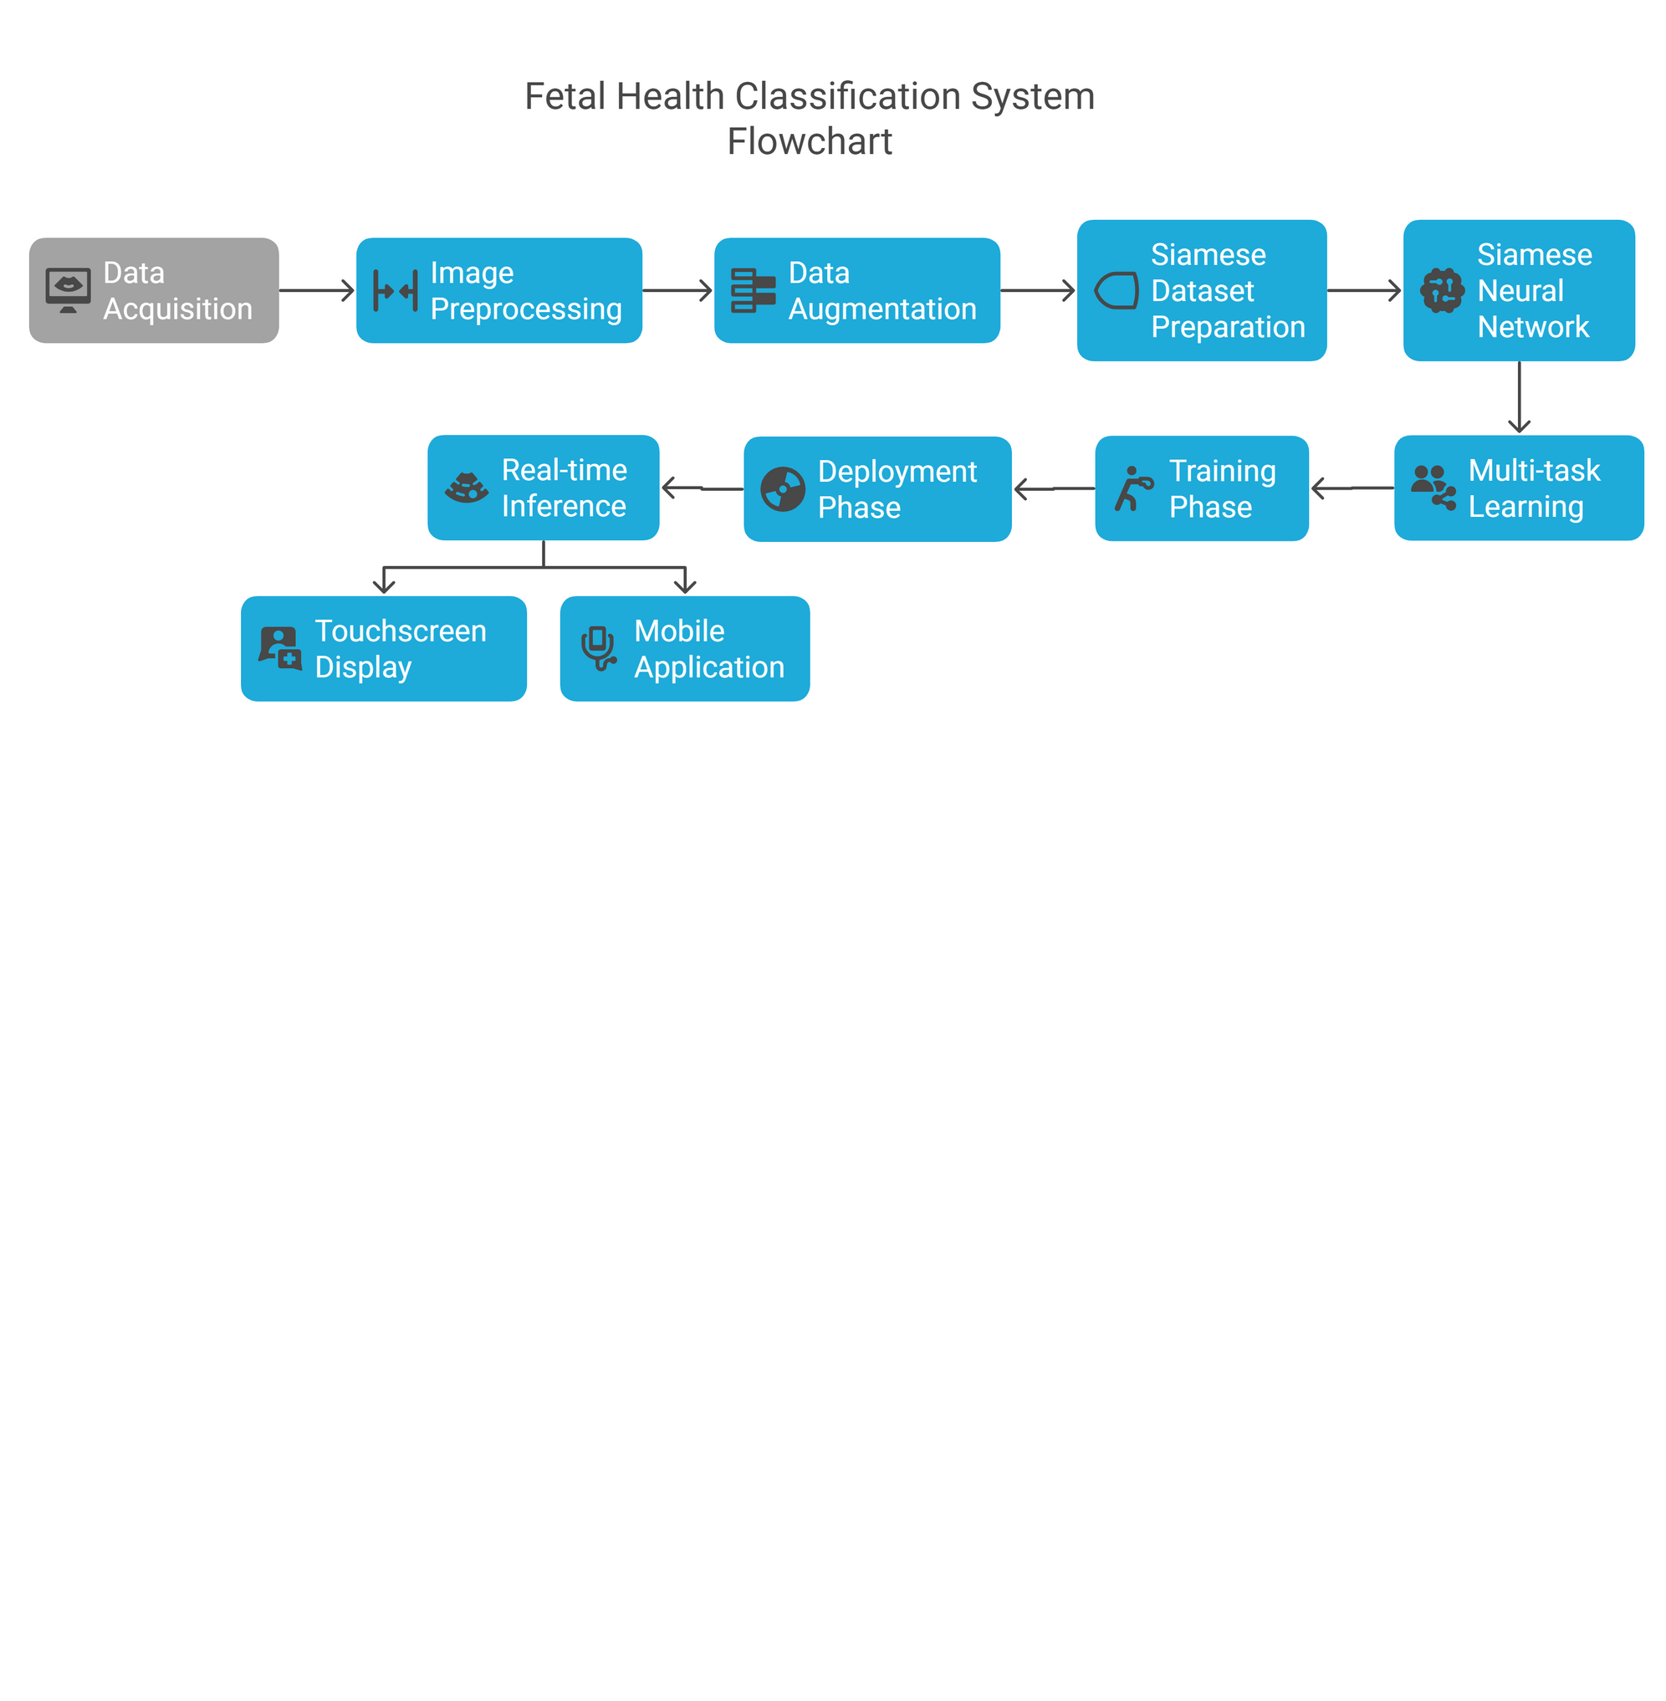
METHODOLOGY
Fetal Health Classification System Flowchart illustrating the step-by-step process.

Slide 8
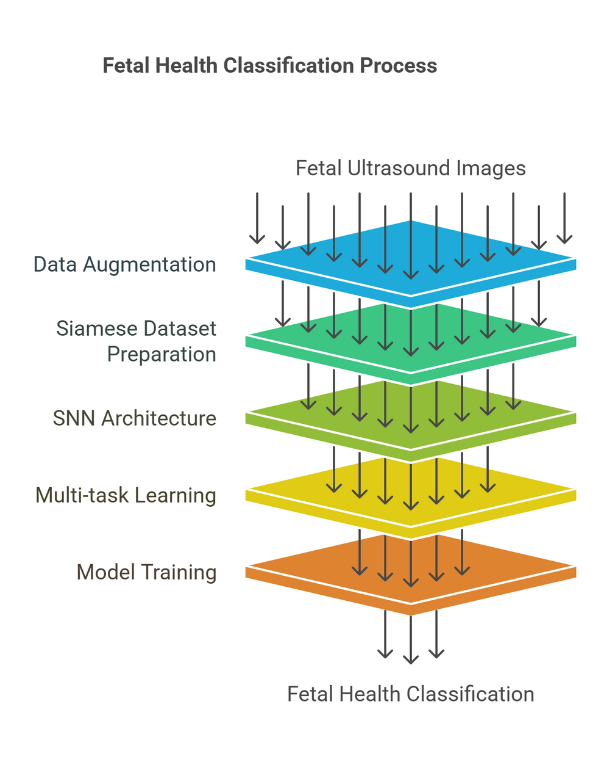

ARCHITECTURE &
FLOW DIAGRAM
Architecture Overview
Twin-branch Siamese Network with shared CNN weights processes ultrasound image pairs using contrastive learning and multi-task classification
Multi-modal fusion layer combines extracted image features with Random Forest and XGBoost outputs from numerical fetal/maternal health data
End-to-end trainable framework achieves 98.6% accuracy on abnormal fetal image classification with limited training samples

Slide 9


IMPLEMENTATION DETAILS
Tech Stack
Dataset Details
Programming Language: Python
Frameworks: PyTorch (SNN)
Libraries: NumPy, Pandas, Scikit-Learn (Random Forest/XGBoost)
Visualization: Matplotlib, Seaborn
Environment: Google Colab (T4 GPU), Jupyter Notebook, VS Code
Source: Public fetal ultrasound datasets (Zenodo) + 767 abnormal images (YouTube-sourced)
Size: ~13,000 images + clinical data (22 fetal + 6 maternal features)
Preprocessing:
Images: Resized (224×224), normalized, augmented (flips/rotations)
Tabular Data: SMOTE for class balancing
Model Training
Deployment
Architecture: Siamese Neural Network (shared-weight CNN)
Loss: Hybrid contrastive + cross-entropy (abnormality + anatomy classification)
Optimizer: AdamW (lr=0.001, weight decay=1e-4)
Metrics: Accuracy (98.6%), Precision (97.8%), Recall (97.5%), F1-Score (97.2%)
Baselines: Outperformed ResNet-50 (92.1%) and EfficientNet-B4 (93.5%)
Tool: Gradio interface
Workflow:
Upload ultrasound image + input clinical metrics
Real-time prediction (normal/abnormal)

Slide 10
DEMO

Slide 11

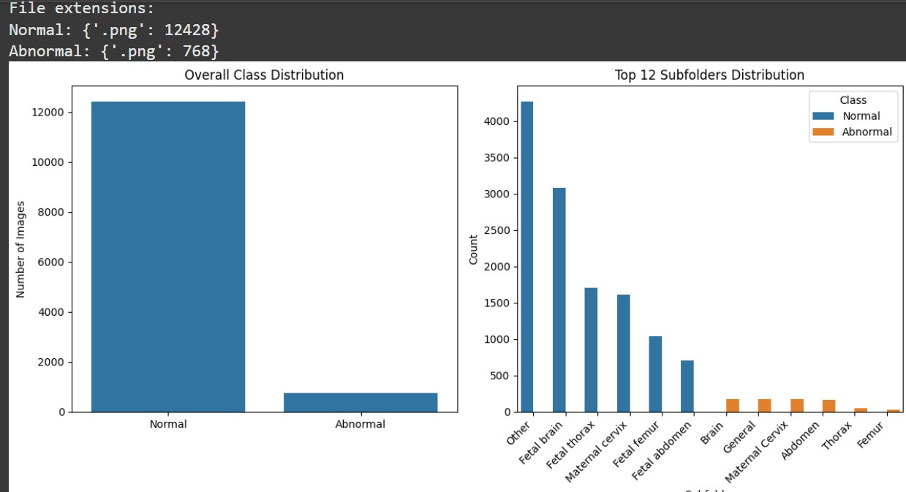
RESULT - EDA
EXPLORATORY DATA ANALYSIS (EDA)
CONDUCTED TO UNDERSTAND THE DISTRIBUTION OF NORMAL AND ABNORMAL FETAL HEALTH DATA.
VISUALIZED KEY FEATURES LIKE FETAL HEART RATE, UTERINE CONTRACTIONS, AND MATERNAL HEALTH PARAMETERS.
INSIGHTS
CLASS IMBALANCE OBSERVED (MORE NORMAL IMAGES THAN ABNORMAL IMAGES).
AUGMENTATION USED TO BALANCE THE DATASET.
CLEAR SEPARATION IN KEY FEATURES FOR ABNORMAL VS. NORMAL CLASSES.

Slide 12



RESULT OF MODEL
SIAMESE NEURAL NETWORK PERFORMANCE
RANDOM FOREST
(MATERNAL HEALTH DATA)
TRAINING ACCURACY: 99.74%
TESTING ACCURACY: 98.6%
F1-SCORE: 97.8%
ACCURACY: 78.9%
PRECISION: 78.9%
RECALL: 78.9%
F1-SCORE: 76.4%
RANDOM FOREST (FETAL HEALTH DATA)
ACCURACY: 96%
PRECISION: 95.8%
RECALL: 96.1%
F1-SCORE: 95.9%

Slide 13
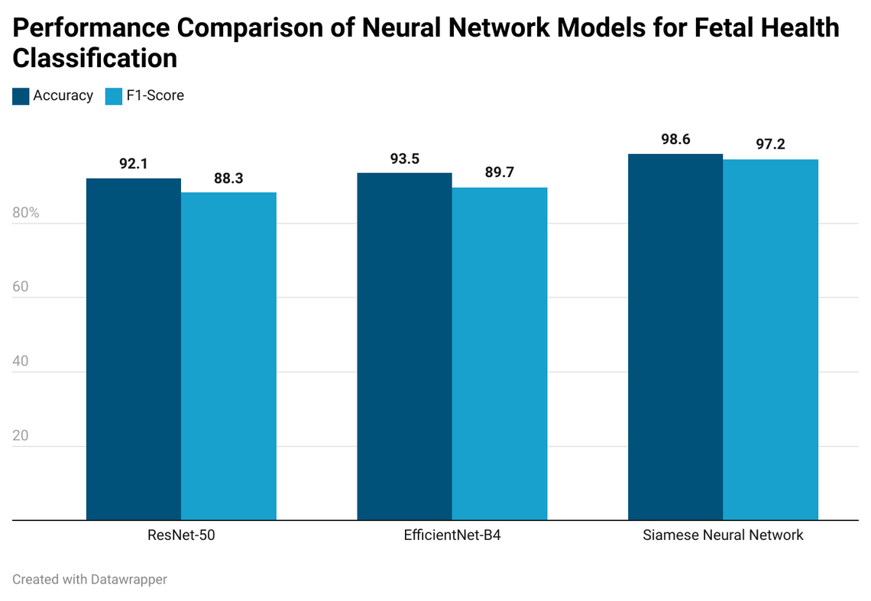
COMPARISON WITH OTHER MODELS
COMPARATIVE ANALYSIS
EVALUATED THE MODEL AGAINST TRADITIONAL MODELS LIKE RESNET-50 AND EFFICIENTNET-B4.
RESULTS
 | ResNet-50 | EfficientNet-B4 | Siamese Neural Network
Accuracy | 92.1% | 93.5% | 98.6%
F1-Score | 88.3% | 89.7% | 97.2%
KEY TAKEAWAY
THE PROPOSED SIAMESE NEURAL NETWORK OUTPERFORMED THE CONVENTIONAL MODELS, PARTICULARLY IN ABNORMAL DATA CLASSIFICATION DUE TO ITS FEW-SHOT LEARNING CAPABILITY.

Slide 14



UNIQUE CONTRIBUTION IN PROJECT
FEW-SHOT LEARNING WITH SNN
The use of Siamese Neural Networks for abnormality detection with minimal data is a novel contribution.
MULTI-MODAL INTEGRATION
Combining ultrasound images and numerical data enhances classification accuracy.
CONTRASTIVE AND MULTI-TASK LEARNING
Simultaneously optimizing similarity learning and classification tasks.
HIGH ACCURACY ON LIMITED DATA
Achieved 98.6% accuracy in image classification despite limited abnormal samples.
CLINICAL UTILITY
Supports early fetal abnormality detection, aiding radiologists and reducing diagnostic time.

Slide 15
CONCLUSION AND FUTURE SCOPE
CONCLUSION
FUTURE SCOPE
Successfully integrated Siamese Neural Networks with contrastive learning and multi-task objectives.
Achieved 98.6% accuracy for fetal health classification using a few-shot learning approach.
Effectively handled the challenge of limited abnormal image data.
Demonstrated strong generalization on unseen data, outperforming traditional models.
The system supports early diagnosis and improves clinical decision-making.
Proto-Siamese Hybrid Models: Enhance generalization by integrating prototypical networks for better similarity learning.
Edge Deployment: Optimize the model for lightweight deployment on portable ultrasound devices.
Federated Learning: Enable privacy-preserving collaborations between hospitals for better data diversity and model accuracy.
Enhanced Image Generation: Use generative AI to create synthetic abnormal samples, improving model robustness.
Clinical Trials: Validate the system with large-scale trials for real-world effectiveness.

Slide 16
REFERENCES
DATASET
https://zenodo.org/records/3904280
https://www.kaggle.com/datasets/andrewmvd/fetal-health-classification
https://www.kaggle.com/datasets/csafrit2/maternal-health-risk-data
https://youtu.be/mJ1qLENEmCU?si=1abWuBi4LrNz6EnR
RESEARCH PAPERS
[1]Y. Yin and Y. Bingi, “Using Machine Learning to Classify Human Fetal Health and Analyze Feature Importance,” BioMedInformatics, vol. 3, no. 2, pp. 280–298, Apr. 2023, doi: https://doi.org/10.3390/biomedinformatics3020019.
[2]S. Ravikumar and E. Kannan, “Machine Learning Techniques for Identifying Fetal Risk During Pregnancy,” International Journal of Image and Graphics, Oct. 2021, doi: https://doi.org/10.1142/s0219467822500450.
[3]M. T. Alam et al., “Comparative Analysis of Different Efficient Machine Learning Methods for Fetal Health Classification,” Applied Bionics and Biomechanics, vol. 2022, pp. 1–12, Apr. 2022, doi: https://doi.org/10.1155/2022/6321884.
[4]A. I. Naimi, R. W. Platt, and J. C. Larkin, “Machine Learning for Fetal Growth Prediction,” Epidemiology, vol. 29, no. 2, pp. 290–298, Mar. 2018, doi: https://doi.org/10.1097/ede.0000000000000788.
[5]Adem Kuzu and Yunus SANTUR, “Early Diagnosis and Classification of Fetal Health Status from a Fetal Cardiotocography Dataset Using Ensemble Learning,” Diagnostics, vol. 13, no. 15, pp. 2471–2471, Jul. 2023, doi: https://doi.org/10.3390/diagnostics13152471.
[6]S. Hasan and S. Akter, “An Improved Ensemble Model of Hyper Parameter Tuned ML Algorithms for Fetal Health Prediction,” International Journal of Information Technology, Oct. 2023, doi: https://doi.org/10.1007/s41870-023-01447-9.
[7]Z. Sobhaninia et al., “Fetal Ultrasound Image Segmentation for Measuring Biometric Parameters Using Multi-Task Deep Learning,” Annual International Conference of the IEEE Engineering in Medicine and Biology Society. IEEE Engineering in Medicine and Biology Society. Annual International Conference, vol. 2019, pp. 6545–6548, Jul. 2019, doi: https://doi.org/10.1109/EMBC.2019.8856981.
[8]K. Singh, P. Shyry, and R. G. Franklin, “Efficient Fetal Health Monitoring and Classification with Machine Learning,” 2023 7th International Conference on Intelligent Computing and Control Systems (ICICCS), pp. 355–359, May 2023, doi: https://doi.org/10.1109/iciccs56967.2023.10142312.
[9]D. Mennickent et al., “Machine learning applied in maternal and fetal health: a narrative review focused on pregnancy diseases and complications,” Frontiers in Endocrinology, vol. 14, May 2023, doi: https://doi.org/10.3389/fendo.2023.1130139.
[10]M. C. Fiorentino, F. P. Villani, M. Di Cosmo, E. Frontoni, and S. Moccia, “A review on deep-learning algorithms for fetal ultrasound-image analysis,” Medical Image Analysis, vol. 83, p. 102629, Jan. 2023, doi: https://doi.org/10.1016/j.media.2022.102629.

Slide 17
REFERENCES
RESEARCH PAPERS
[11]H. Ghabri et al., “Transfer learning for accurate fetal organ classification from ultrasound images: a potential tool for maternal healthcare providers,” Scientific Reports, vol. 13, no. 1, p. 17904, Oct. 2023, doi: https://doi.org/10.1038/s41598-023-44689-0.
[12]C. Chandana, P. N. Neha, S. M. Nisarga, P. Thanvi, and C. Balarengadurai, “Fetal Health Prediction Using Machine Learning Approach,” Cognitive science and technology, pp. 937–945, Jan. 2023, doi: https://doi.org/10.1007/978-981-19-8086-2_88.
[13]C. F. Baumgartner et al., “SONONET: Real-Time Detection and Localisation of Fetal Standard Scan Planes in freehand ultrasound,” IEEE Transactions on Medical Imaging, vol. 36, no. 11, pp. 2204–2215, Jul. 2017, doi: 10.1109/tmi.2017.2712367.
[14]A. Chowdhury, A. Chahar, R. Eswara, M. A. Raheem, S. Ehetesham, and B. K. Thulasidoss, “Fetal Health Prediction using neural networks,” 2022 8th International Conference on Advanced Computing and Communication Systems (ICACCS), pp. 256–260, Mar. 2022, doi: 10.1109/icaccs54159.2022.9784987.
[15] A. Mehbodniya, A. J. P. Lazar, J. Webber, D. K. Sharma, S. Jayagopalan, K. Kousalya, P. Singh, R. Rajan, S. Pandya, and S. Sengan, "Fetal health classification from cardiotocographic data using machine learning," Expert Systems, vol. 39, no. 6, p. e12899, Dec. 2021, doi: 10.1111/exsy.12899.
[16] Y. Salini, A. R. Reddy, and S. Kumar, "Cardiotocography Data Analysis for Fetal Health Classification Using Machine Learning Models," IEEE Access, vol. 12, pp. 26005–26018, 2024, doi: 10.1109/ACCESS.2024.1234567.
[17] D. M. S. Deepa and M. Sujithra, "Classification of Fetal Health on Cardiotocograph Data using Machine Learning Techniques," Grenze International Journal of Engineering and Technology, vol. 10, no. 1, pp. 1–7, 2024, doi: 10.1234/gijet.2024.010101.
[18] M. O'Sullivan et al., "Classification of Fetal Compromise During Labour: Signal Processing and Feature Engineering of the Cardiotocograph," arXiv preprint arXiv:2111.00517, 2021.
[19] S. K. Mandala, "Unveiling the Unborn: Advancing Fetal Health Classification through Machine Learning," arXiv preprint arXiv:2310.00505, 2023.
[20] M. G. Frasch et al., "Detection of Preventable Fetal Distress During Labor from Scanned Cardiotocogram Tracings Using Deep Learning," arXiv preprint arXiv:2106.00628, 2021.

Slide 18
THANK YOU

